Slide 1
Hyper spectral imaging classification of head and neck squamous cell carcinoma using wavelet CNN (SpectralNET)
Project final presentation
Team purple
Nati Nawawithan
Vinay Kadam
BMEN 6367 Artificial Intelligence in Biomedical Engineering
Fall 2022

Slide 2
Objectives and Purposes
Purpose
This project focuses on detection of head and neck tumor and normal areas in specimens using wavelet CNN (SpectralNET).
Objectives
To predict normal and tumor areas in non-label hyperspectral images of unseen data.
To compare the results of tumor detection with and without factor analysis in 44 tissue specimens.
To find the optimal hyperparameters to train our dataset using wavelet CNN (SpectralNET)

Slide 3
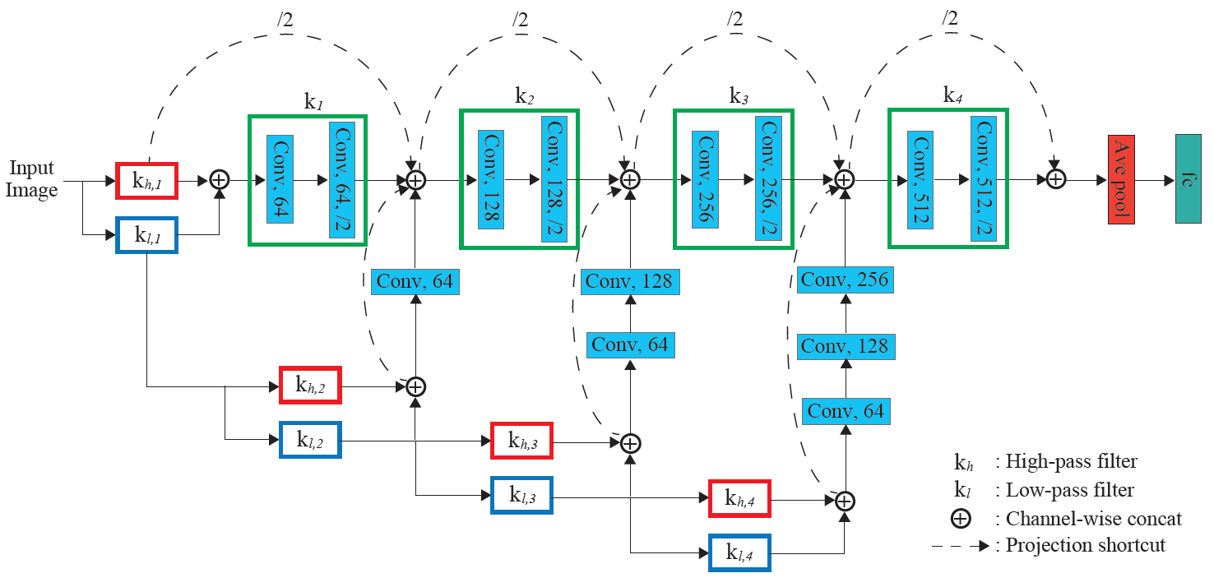
Method
Wavelet CNN (SpectralNET) Algorithm

Slide 4
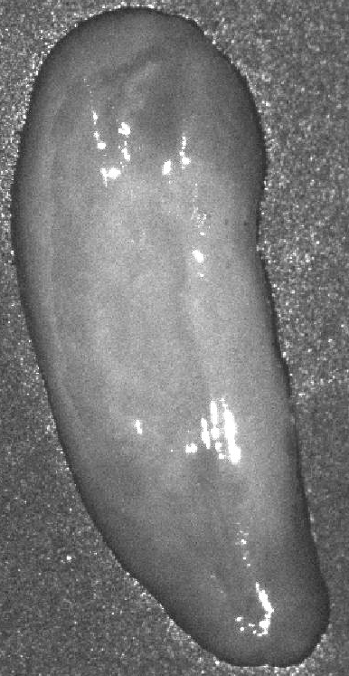

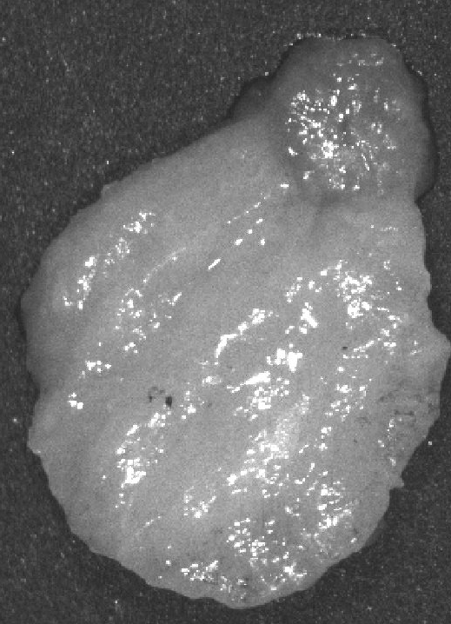

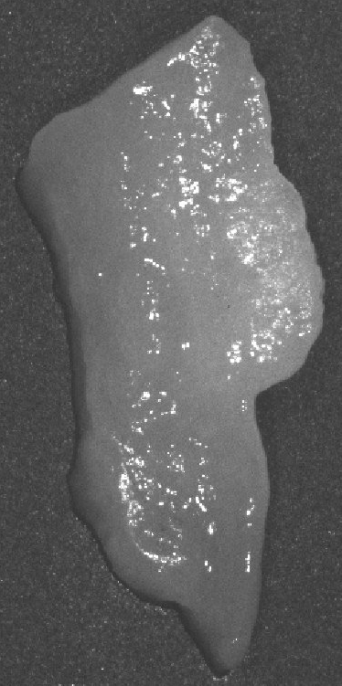
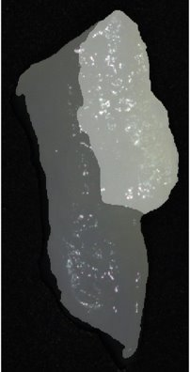
Implementation details
Training Data
Normal Tissue
Tumor Tissue
HSI
Mask
HSI
Mask
Testing Data
Tumor and Normal Tissue
HSI
Rgb+Mask

Slide 5
Implementation details
Load data
Create
patches
Concatenate
All patches
Train and test split
Dimension: (n, x, y, 91)
Type : .mat file
Dimension: (n, m, 24, 24, 91)
Dimension: (m, 24, 24, 91)
80:20
Wavelet
transform
CNN
Predict mask
Loss function: Binary CE
Epochs:30
Batch size: 32
Early stopping

Slide 6
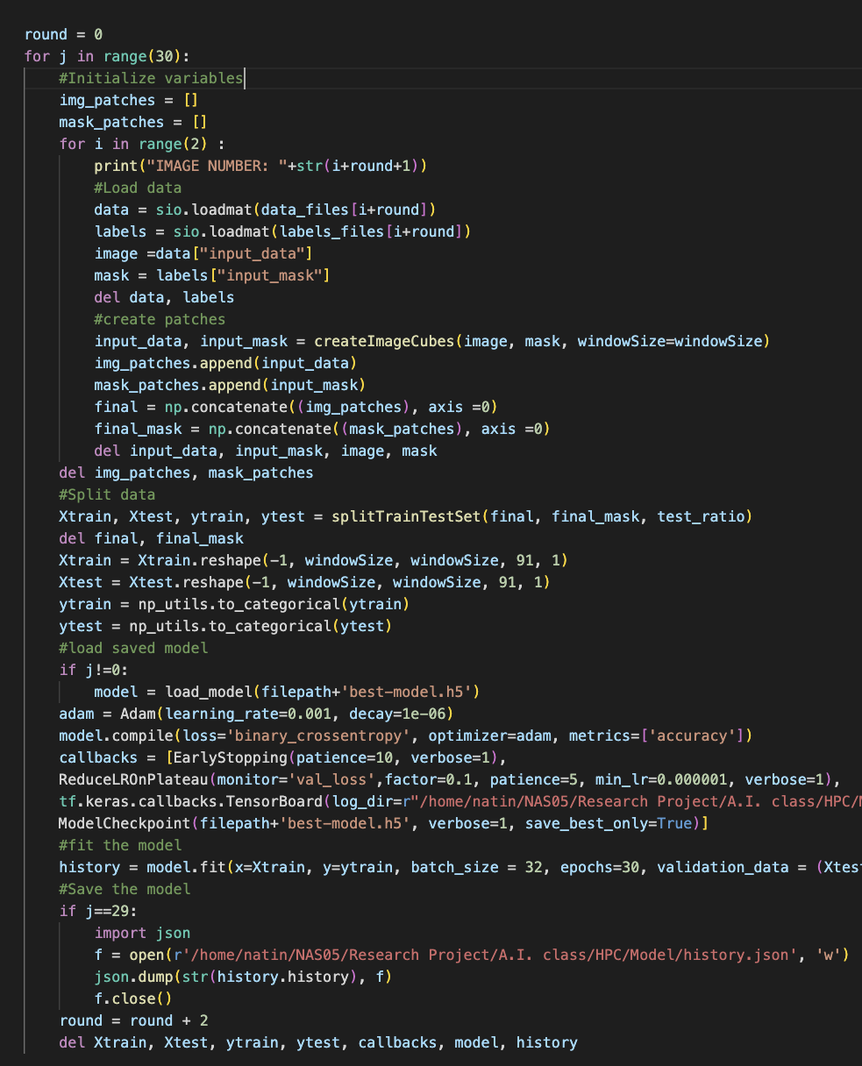
Implementation details
Memory management
Tracking
Checking line number and variables of errors
Managing
Removing redundant variables created
Optimizing
Deleting the arrays after been used

Slide 7
Implementation details
Experiments
Training dataset = 44 images​
22 images contain only normal tissue ​
22 images contain only tumor tissue
Testing dataset = 1 image contain both normal and tumor regions
Stage | Parameters
1 | Patch size = 24x24 Batch size = 32 Epoch = 30 Factor analysis = 10
2 | Patch size = 24x24 Batch size = 32 Epoch = 30
3 | Patch size = 24x24 Batch size = 16 Epoch = 30

Slide 8
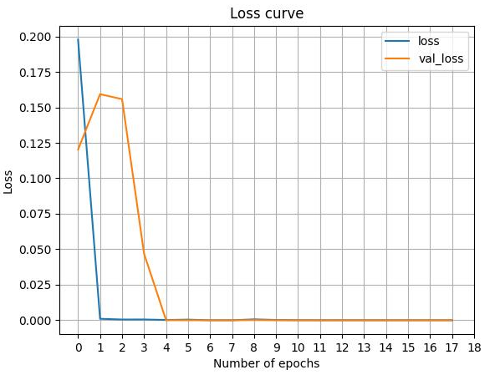
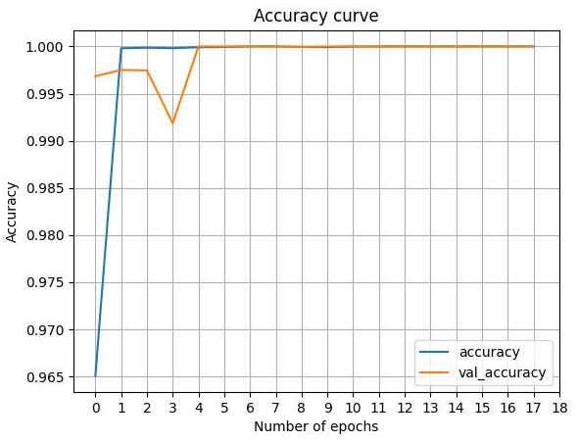
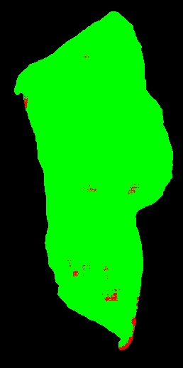
Results
Stage 1 (Factor analysis)
IoU = 0.48
Predicted image
Ground truth image

Slide 9
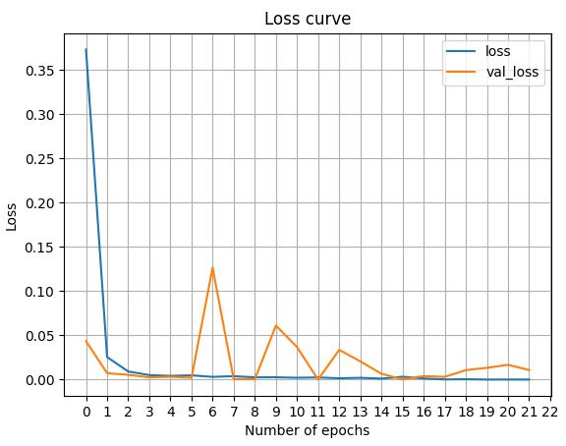
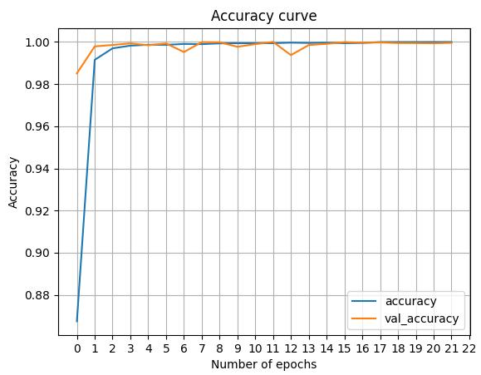
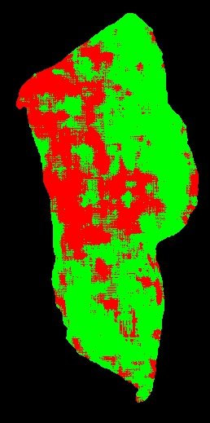
Results
Stage 2
IoU = 0.59
Predicted image
Ground truth image

Slide 10
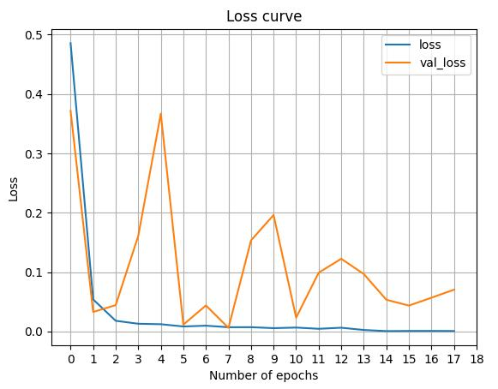
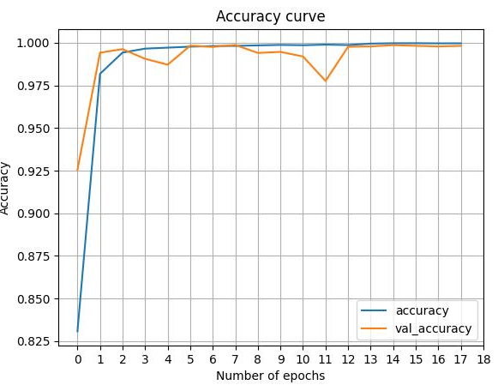
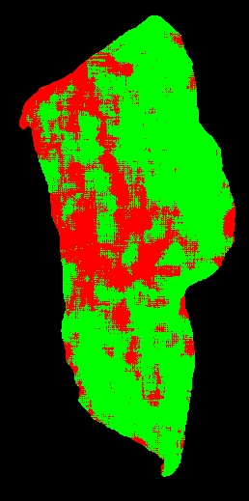
Results
Stage 3 (Reduced batch size)
IoU = 0.58
Predicted image
Ground truth image

Slide 11
Conclusion
Our results show that there is still a need for improvement and we need to train the model with more data.
We observed that factor analysis does not contribute to getting rich features for model prediction. So, all 91 bands of the spectral analysis should be used.

Slide 12
Contributions
Nati:
Prepare dataset
Plan the experiment
Apply algorithm to train dataset
Purpose, Objectives
Method
Implementation details
Results
Vinay:
Set up environment in HPC
Memory efficient coding
Apply algorithm to train dataset
Objectives
Implementation details
Conclusion

